Slide 1
Welcome to my presentation

Slide 2

TECHNOLOGY UNIVERSITY(KALAY)
DEPARTMENT OF ELECTRONIC
ENGINEERING
DESIGN AND IMPLEMENTATION OF
ROBOTIC ARM
(Android Software Implementation)
Supervisor – Daw Cho Thet Nwe
Presented by
Mg Aung Ye Htet ( VI EC- 47 )
Defense 6.10.2018

Slide 3
Outline of Presentation
Abstract
Aim and Objectives
Introduction
Overall System Block Diagram
Application Areas
Android Software
Implementation Program
Expected Outcomes
Conclusion
Arduino Software Implementation
Circuit Implementation
Hardware Implementation

Slide 4
Abstract
An articulated robotic arm is designed and implemented to pick up the weight of 300g by controlling android phone.
Arduino microcontroller is the main control function of the system.
Bluetooth module supports robotic arm as a wireless interface between the robotic arm and the android phone.
There are five joints in robotic arm so that it support five degree of freedom to perfectly work of gripping.

Slide 5
Aim and Objectives
To design and implement of Robotic Arm
To evaluate the mathematical coordinates

Slide 6
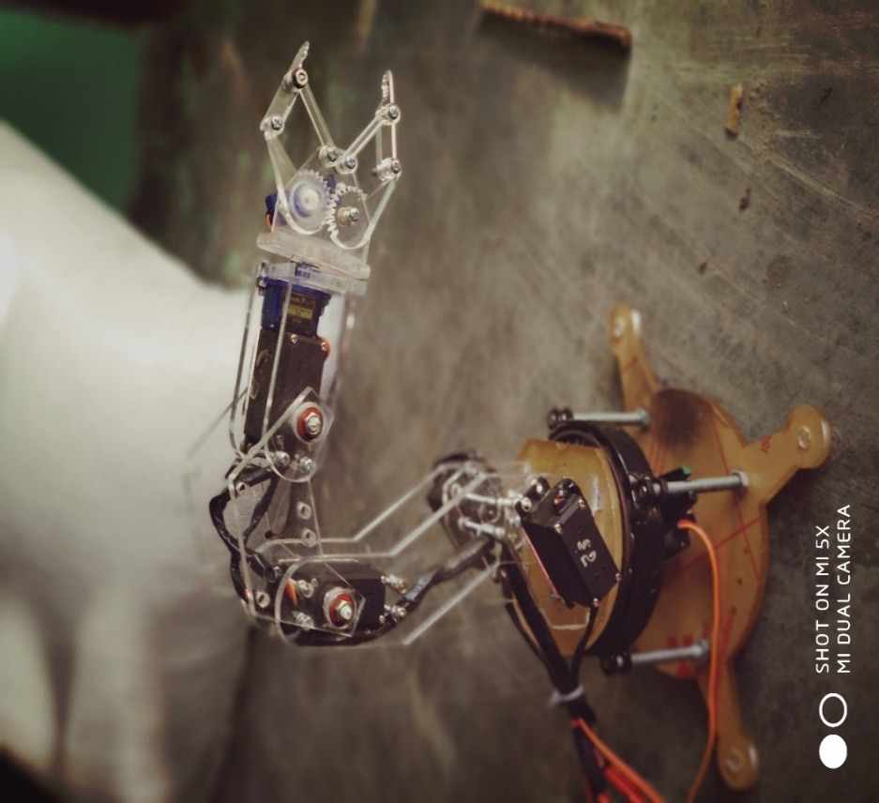
Introduction
A robot consisting of parts linked together in the same way as those of a human arm, mounted on a stand.
The most common manufacturing robot is the robot arm which is usually made up of several metal segments.

Slide 7
Types of Robotic Arm
Cartesian Robotic Arm
Cylindrical Robotic Arm
Polar Robotic Arm
SCARA Robotic Arm
Articulated Robotic Arm

Slide 8
Microcontroller
Servo
Servo
E2
Servo
Bluetooth
module
Servo
Servo Motor
Driver
Servo
E1
Servo
Android
phone
Servo
Figure. Overall System Block Diagram

Slide 9
Application Areas
CNC applications
Industrial manufactures
Drawing applications
Chemical Laboratory

Slide 10
Android Program
Android Studio SDK
Android Studio Project
Android Application

Slide 11

1. Android Studio SDK
Android Studio is the official integrated development environment for Google’s Android operating system
Figure . Android Studio Software

Slide 12
Android Studio Project
Project Tree
Main Activity
UI Design
Permission

Slide 13
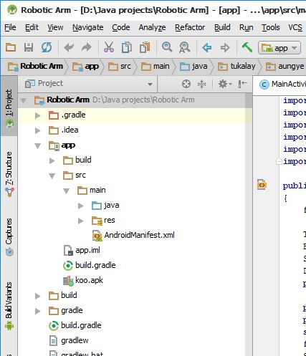
Project Tree
Build for project’s settings
Program folder
Resource folder
Figure. Project Tree of Robotic Arm Controller

Slide 14
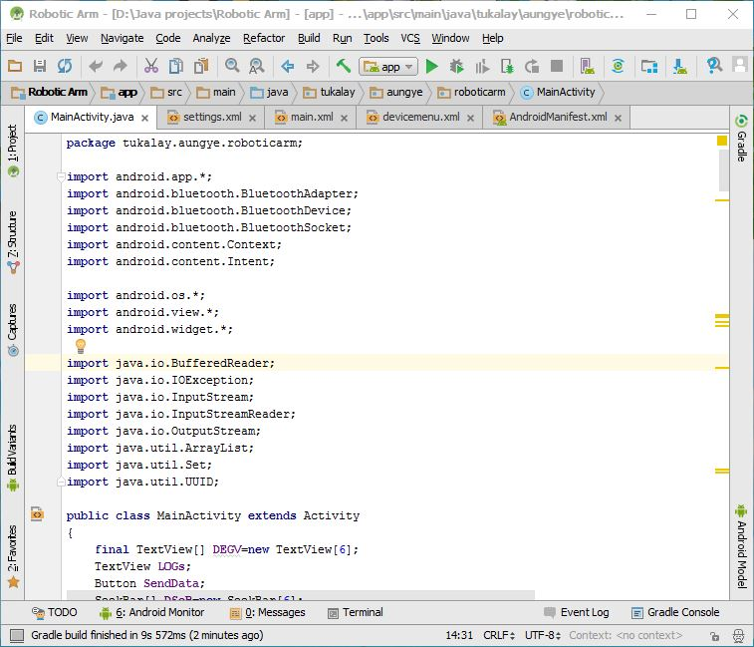
Main Activity
Java programs
Figure. Android Programs in Main Activity.java

Slide 15
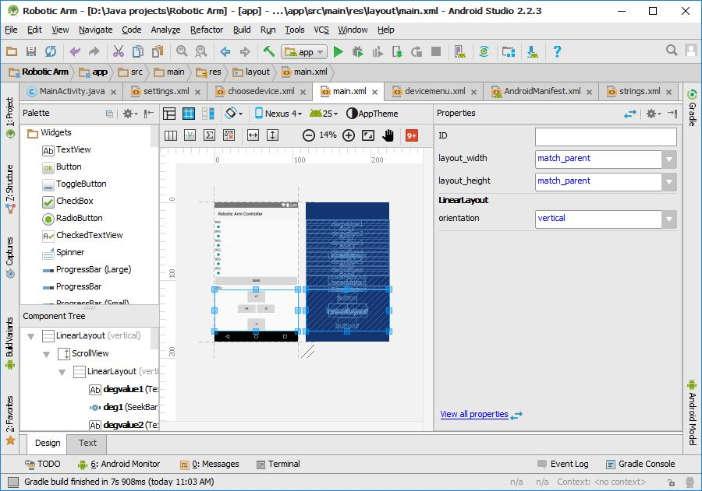
UI Design
Layout Properties
UI Design of Android App.
Figure. UI Designer of Android Studio

Slide 16
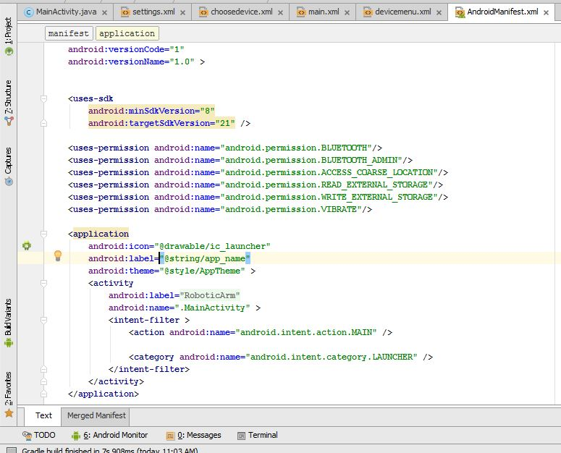
Permission
Target SDK
Permission request
Figure. Permission Script in Manifest.xml

Slide 17
Android Application
Main User Interface
Menu User Interface
Devices User Interface
Configuration User Interface
Control of Robotic Arm

Slide 18
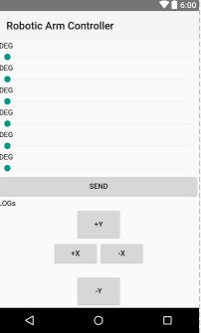
Main User Interface
Degrees for each Joint
Send Desired degrees
X-Y Joint Sticks
Figure. Main User Interface

Slide 19
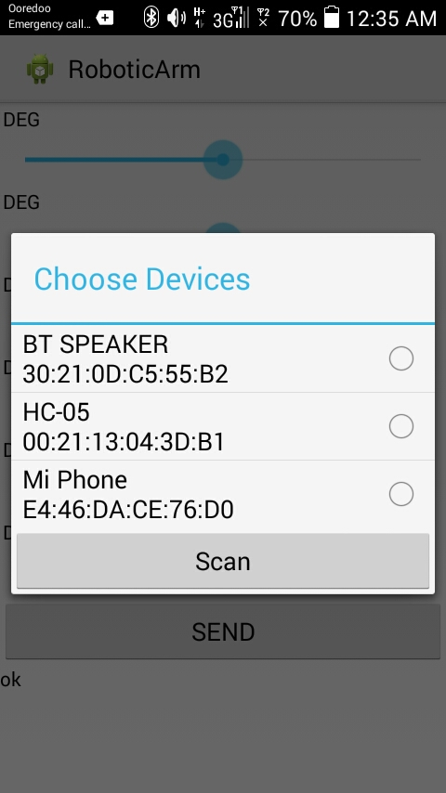
Devices User Interface
Robotic Arm Devices
To Pair and Scan devices
Figure. Choose Device Dialog

Slide 20
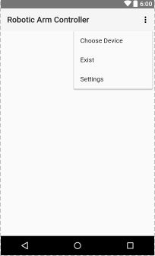
Menu User Interface
Open the Devices dialog
Open the app. settings
Exist from app...
Figure. Menu Option of Robotic Arm Controller

Slide 21
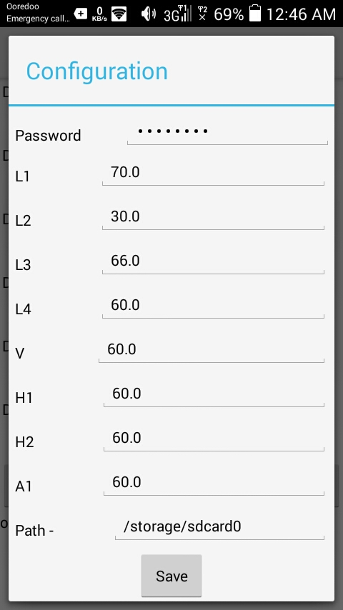
Configuration User Interface
For app protection
Lengths of Robotic Arm
Save the settings
Data Store Path
Figure. Settings Dialog

Slide 22
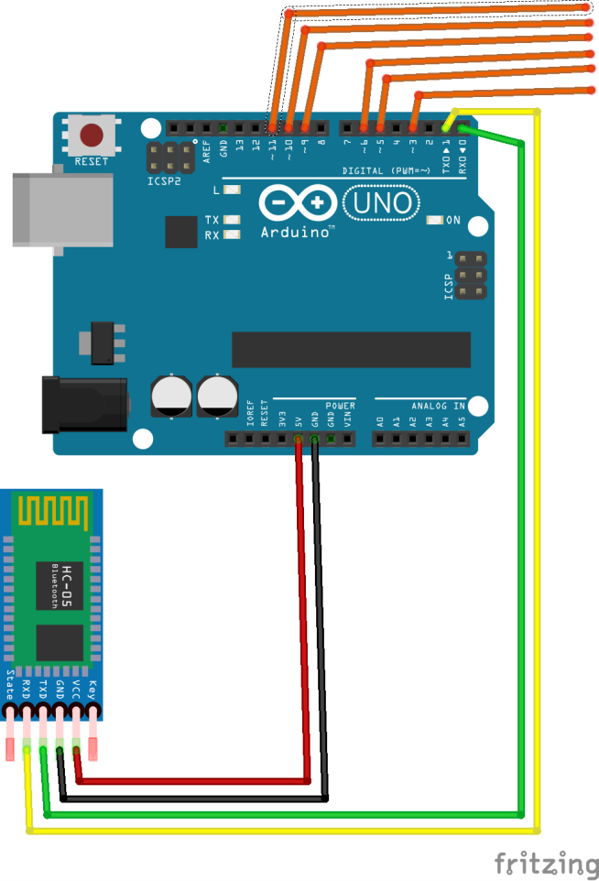
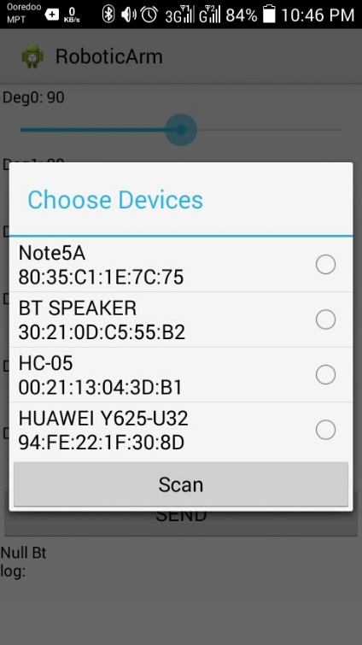

Control of Robotic Arm
Arduino Uno Board
Servo PWM pins
Bluetooth Devices
Servo Degrees
Bluetooth Module
Figure. Controlling the Robotic Arm

Slide 23
Implementation Program
Evaluate the mathematical coordinates.
Design the frames according to calculated math.
Design the circuit diagram suitable for servo motor driven.
Write Arduino program and the android application for arm control and to perform desired tasks.

Slide 24
Expected outcomes
The expected outcomes of the control system of Robotic Arm are:
Getting more stable system and more specific dimension.
May be affected by durable vibration.
May be able to work easily by means of connected android phone.
Saving cost.

Slide 25
Conclusion
The design is simple enough to incorporate subsequent degrees of freedom, since their is just one grooved shaft to be moved in other planes.
The arm is lighter in weight and occupies lesser floor area to accomplish a given task.

Slide 26
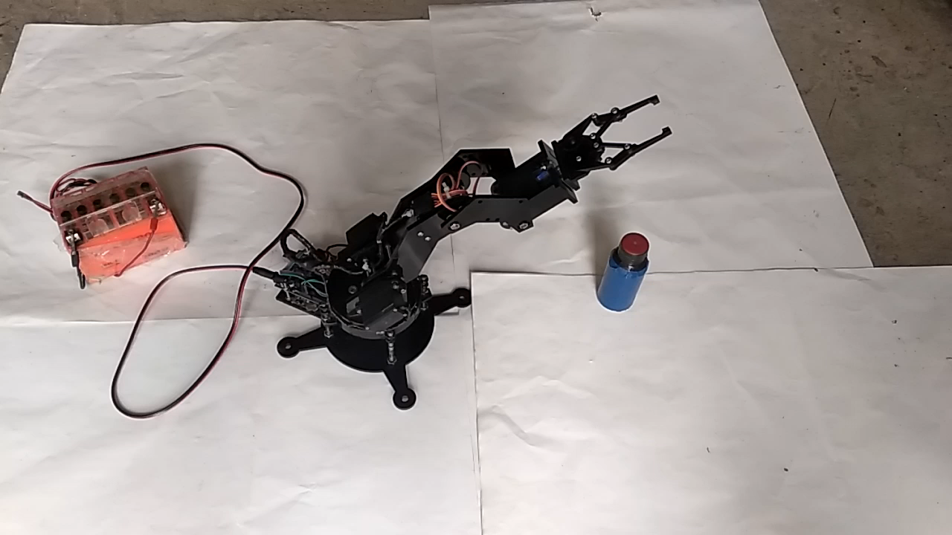

Slide 27
TECHNOLOGY UNIVERSITY(KALAY)
DEPARTMENT OF ELECTRONIC
ENGINEERING
DESIGN AND IMPLEMENTATION OF
ROBOTIC ARM
(Arduino Software Implementation)
Supervisor – Daw Cho Thet Nwe
Presented by
Mg Kyaw Win Tun ( VI EC- 29 )
Defense 6.10.2018

Slide 28
Arduino Software implementation
Mg Kyaw Win Tun
VI EC - 29

Slide 29
Arduino Programming
Robotic Arm Driver Program
Arduino Program installation

Slide 30
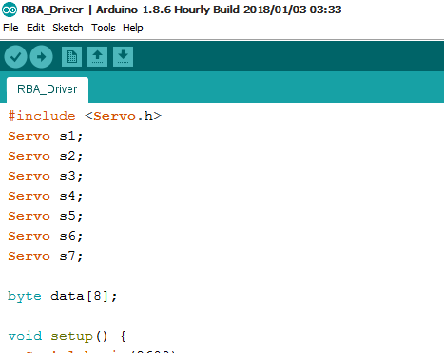
Initialization
Import servo library
Initialize variables for each servo of joint
Initialize byte array
Figure. Initialization in Robotic Arm Driver Program

Slide 31
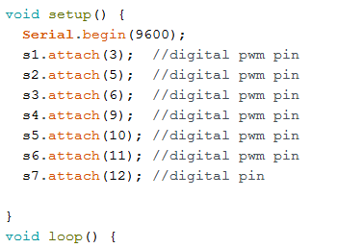
Configuration
Set Arduio Serial’s baud-rate
Set control pins for each servo variable
Figure. Configuration in Robotic Arm Driver Program

Slide 32
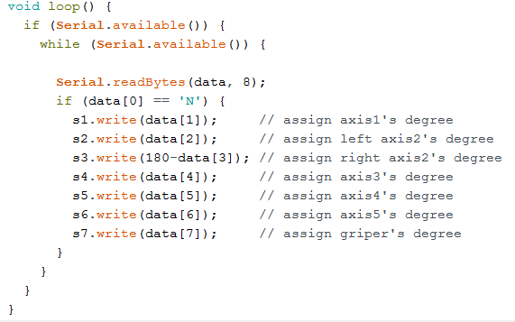
Main Program
Check Serial’s states
Read Serial’s incoming data
Drive the servos by the data from the controller
Figure. Driving Scripts in Robotic Arm Driver Program

Slide 33
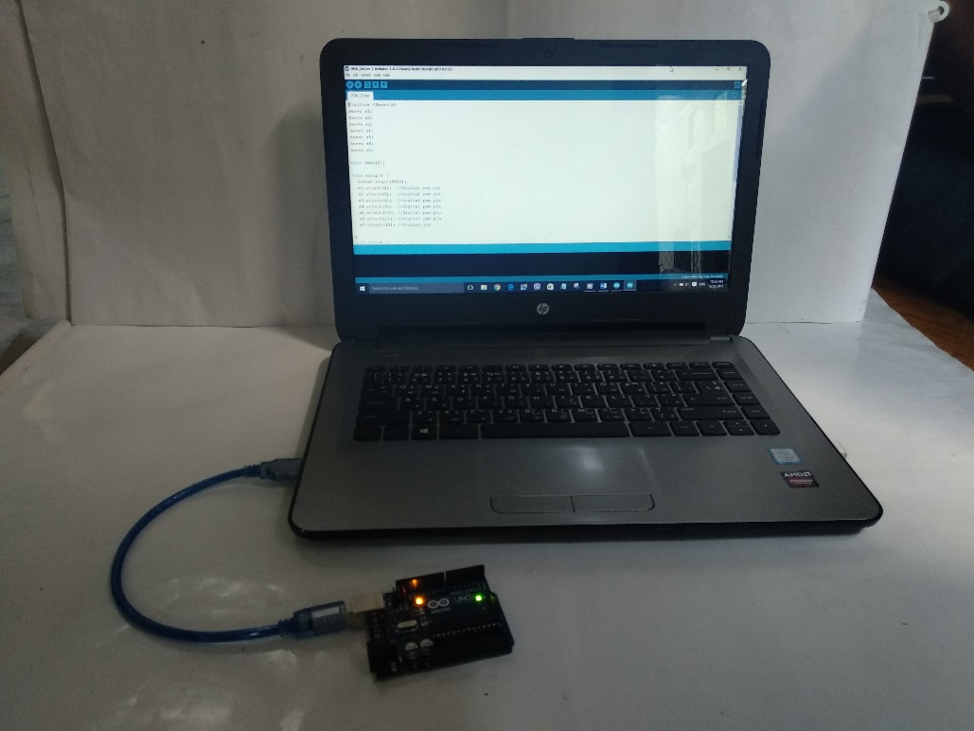
Arduino Program Installation
Compile: is to check the written program and to change from C++ language to machine
Upload: is to transfer the program from the computer to the Arduino board using USB Cable
Figure. Upload the Program to Arduino Board

Slide 34
TECHNOLOGY UNIVERSITY(KALAY)
DEPARTMENT OF ELECTRONIC
ENGINEERING
DESIGN AND IMPLEMENTATION OF
ROBOTIC ARM
(Circuit Implementation)
Supervisor – Daw Cho Thet Nwe
Presented by
Ma Zin Mar Nwe ( VI EC- 3 )
Defense 6.10.2018

Slide 35
Circuit Implementation
Ma Zin Mar Nwe
VI EC - 3

Slide 36
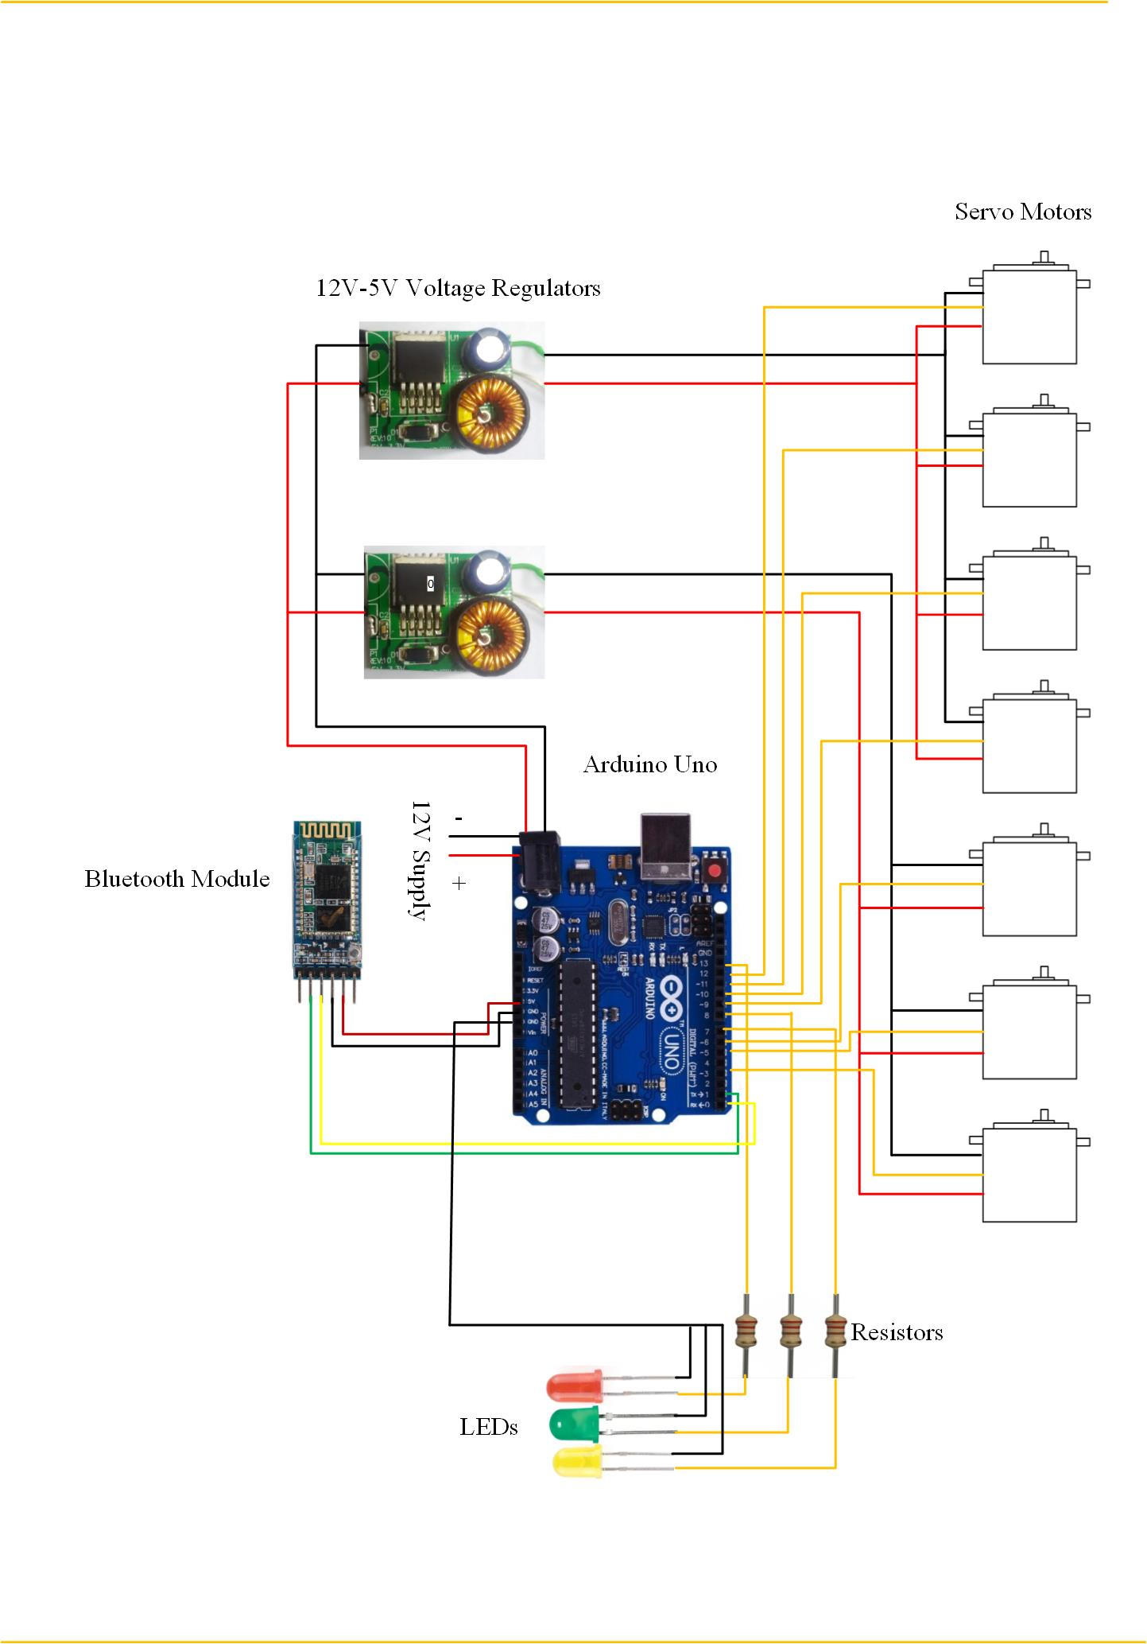
Figure. System Architecture of Robotic Arm

Slide 37
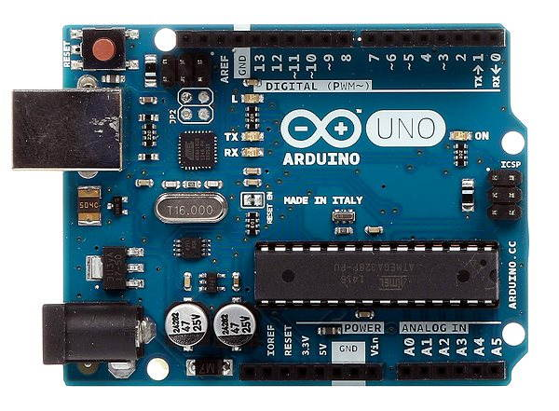
Arduino Uno
Operating voltage: 5V
i/p voltage: 7-12V(recommended)
i/p voltage: 6-20V(limit)
Digital i/o pin: 14 (of which 6 provide PWM output)
Analog i/p pin : 6
DC current per i/o pin : 40mA
DC current per 3.3V pin : 50mA
Figure. Arduino Uno

Slide 38
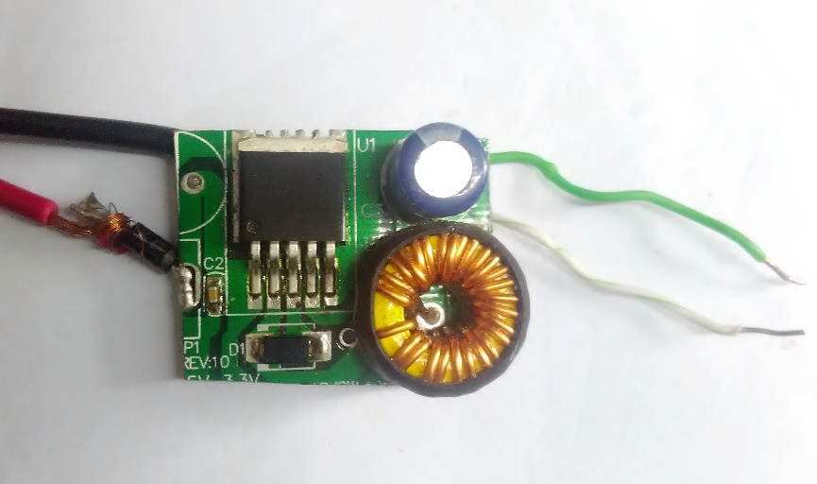
Power Supply
Input voltage : 8V-40V
Output voltage : 5V
Output current :3A
Figure. 12V to 5V DC-DC Step-Down Power Supply

Slide 39
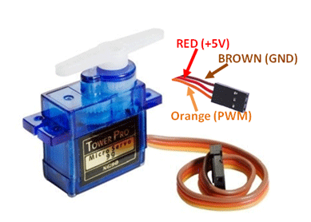
SG90 Servo Motor
Weight:9g
Operating voltage:4.8V(5V)
Stall torque : 1.8kg-cm
Operating speed : 0.1sec/60degree
Figure. SG90 Servo Motor

Slide 40
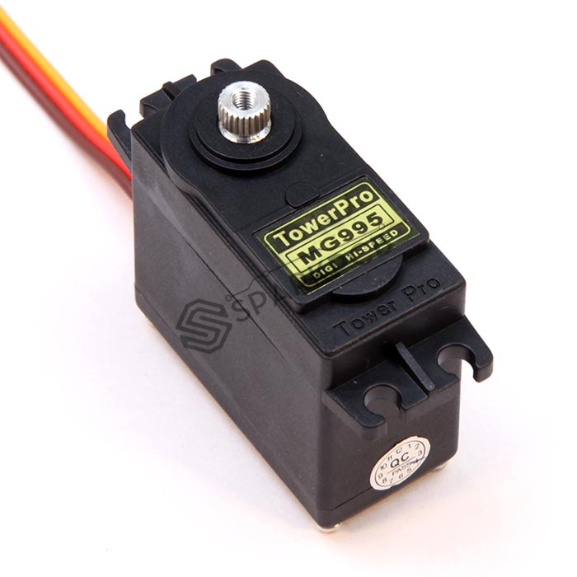
MG995 Servo Motor
Weight : 55g
Operating voltage : 4.8V to 7.2V
Stall torque : 8.5kg-cm(4.8V),
10kg-cm(6V)
Operating speed : 0.2sec/60˚(4.8V),
0.16sec/60˚(6V)
Figure. MG995 Servo Motor

Slide 41
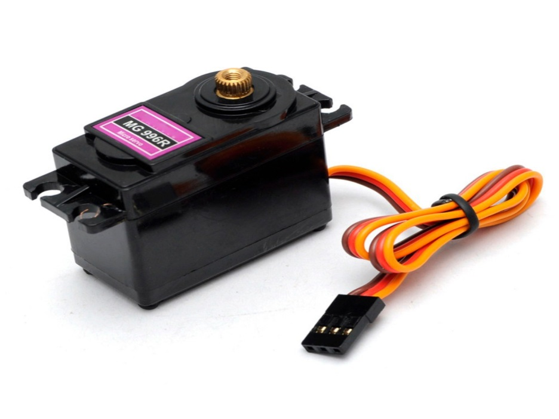
MG996R Servo Motor
Weight :55g
Operating voltage : 4.8V to 7.2V
Stall torque : 9.4kg-cm(4.8V),
11kg-cm(6V)
Operating speed :0.17sec/60˚(4.8V), 0.14sec/60˚(6V)
Figure. MG996R Servo Motor

Slide 42
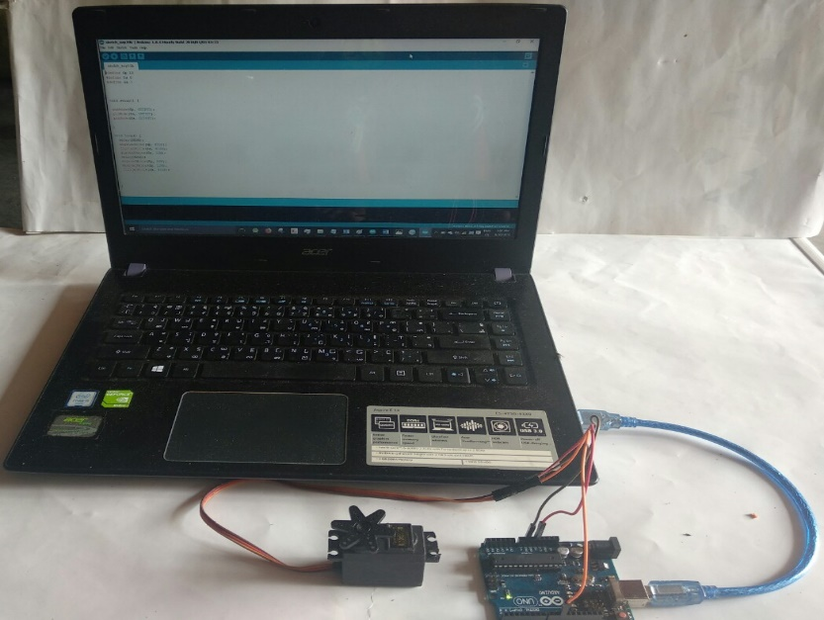
Connect the red wire to the 5V pin on the Arduino.
Connect the yellow wire to the PWM pin on the Arduino.
Connect the brown wire to the GND pin on the Arduino.
Figure. Pin Connections of Servo Motor and Arduino Uno

Slide 43
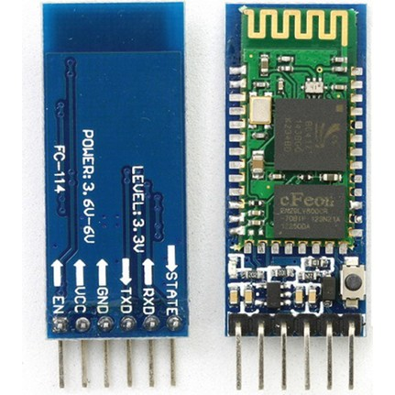
Bluetooth Module
HC-05 Bluetooth module is an easy to use Bluetooth SPP(Serial Port Protocol) module designed for transparent wireless serial connection setup.
Font View
Back View
Button
Figure. HC-05 Bluetooth Module

Slide 44
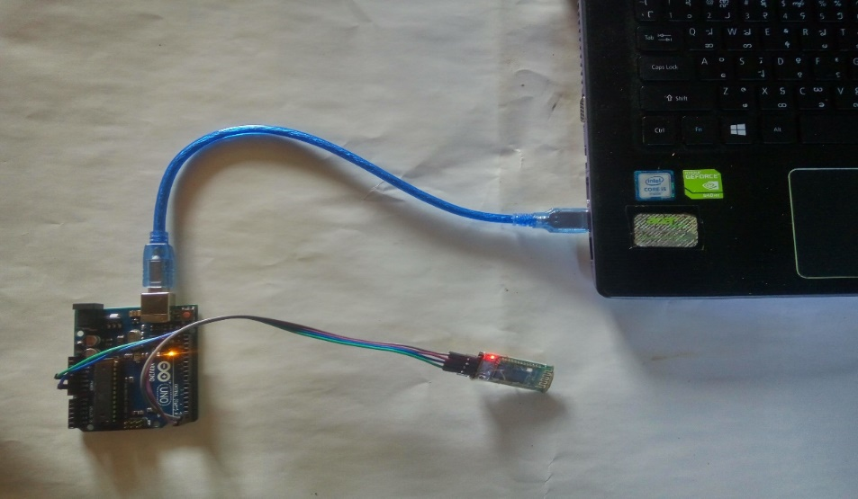
Connect RX pin to TX pin of Arduino
Connect TX pin to RX pin of Arduino
Connect 5V pin to Vin pin of Arduino
Connect GND pin to GND pin of Arduino
Figure. Pin Connections of HC-05 Bluetooth Module and Arduino Uno

Slide 45
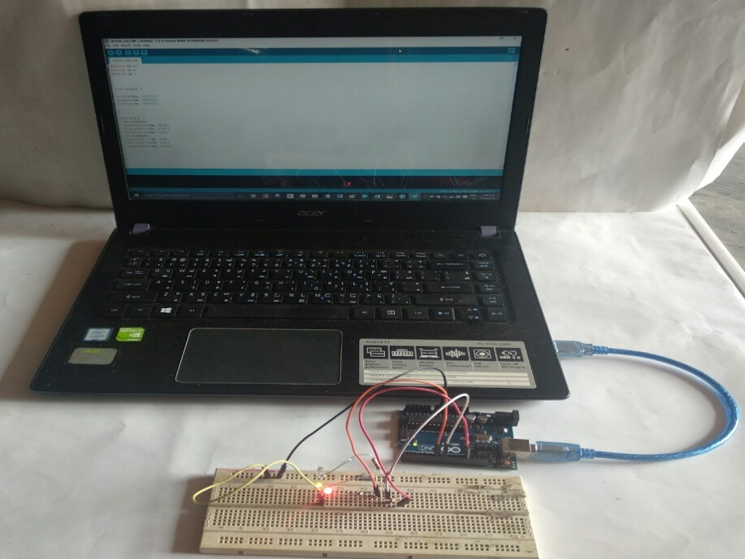
Connect the anode pin of the red LED to the digital pin 13 of the Arduino
Connect the anode pin of the green LED to the digital pin 8 of the Arduino
Connect the anode pin of the green LED to the digital pin 7 of the Arduino
Figure. Pin Connections of LED and Arduino Uno

Slide 46
TECHNOLOGY UNIVERSITY(KALAY)
DEPARTMENT OF ELECTRONIC
ENGINEERING
DESIGN AND IMPLEMENTATION OF
ROBOTIC ARM
(Hardware Implementation)
Supervisor – Daw Cho Thet Nwe
Presented by
Ma Thuzar Myint ( VI EC- 39 )
Defense 6.10.2018

Slide 47
Hardware Implementation
Ma Thuzar Myint
VI EC-39

Slide 48
Hardware Implementation
Components
Frame Designs
Kinematics

Slide 49
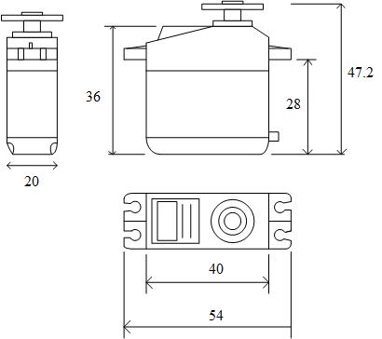
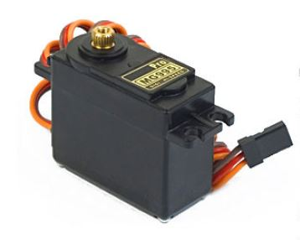
Weight : 55g
Dimension :40.7×19.7×42.9mm
Torque :10kg/cm[6V]
Speed :0.16s/60degree[6V]
Voltage : 4.8V-7.2V
Bandwidth : 5µs
Temperature: 0Ċ-55Ċ
(a)
(b)
Figure. (a) Drawing View of MG995 (b) MG995 Servo Motor

Slide 50
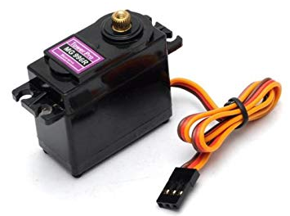
Weight : 55g
Dimension :40.7×19.7×42.9mm
Torque : 11 kg/cm (6 V)
Speed :0.14 s/60º (6 V)
Voltage : 4.8V-7.2V
Bandwidth : 5µs
Temperature: 0Ċ-55Ċ
(a)
(b)
Figure. (a) Drawing View of MG996R (b) MG996R Servo Motor

Slide 51
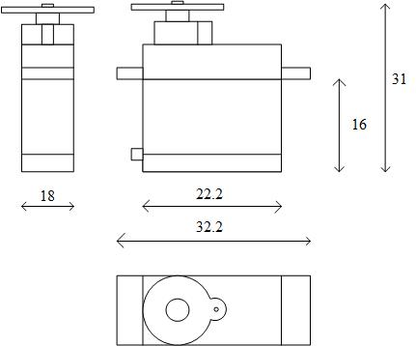
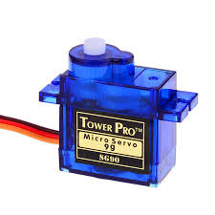
Weight : 14.7 g
Torque : 2.5 kg/cm (6 V)
Speed : 0.1 s/60º (6 V)
Voltage : 4.8V-6V
Bandwidth : 5µs
Temperature: 0Ċ-55Ċ
(a)
(b)
Figure. (a) Drawing View of SG90 (b) SG90 Servo Motor

Slide 52
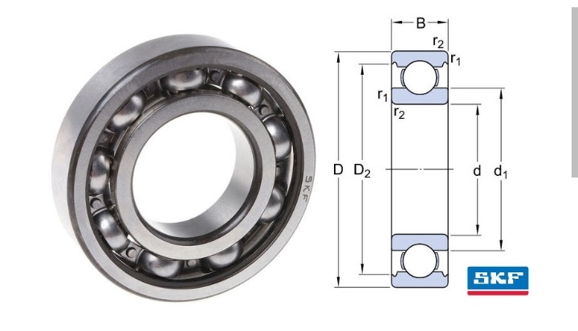
Small Ball Bearing
Inner diameter d :5mm
Outer diameter B :13mm
Reference speed :95000r/min
Limiting speed :60000r/min
Width :5mm
d1 :8.4mm
D :13mm
D2 :12.3mm
r1,r2 min :0.3mm
Figure. Small Ball Bearing

Slide 53
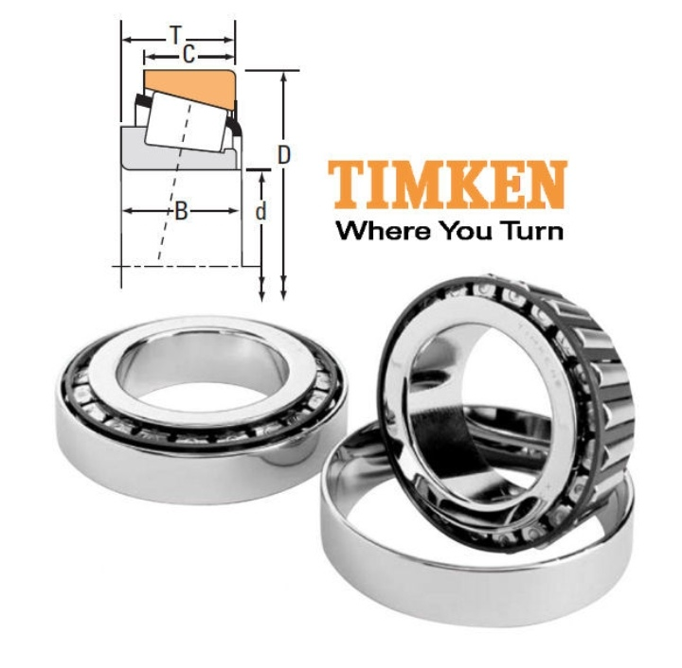
Roller Ball Bearing
Weight :0.7kg
d- Bore :55mm
D – Cup outer diameter: 100mm
B – Cone width :21mm
C – Cup width :18mm
T – Bearing width :22.7mm
Figure. Roller Ball Bearing

Slide 54
Frame Design
Base
Shoulder
Elbow
Gripper Pitch
Gripper Spin
Gripper

Slide 55
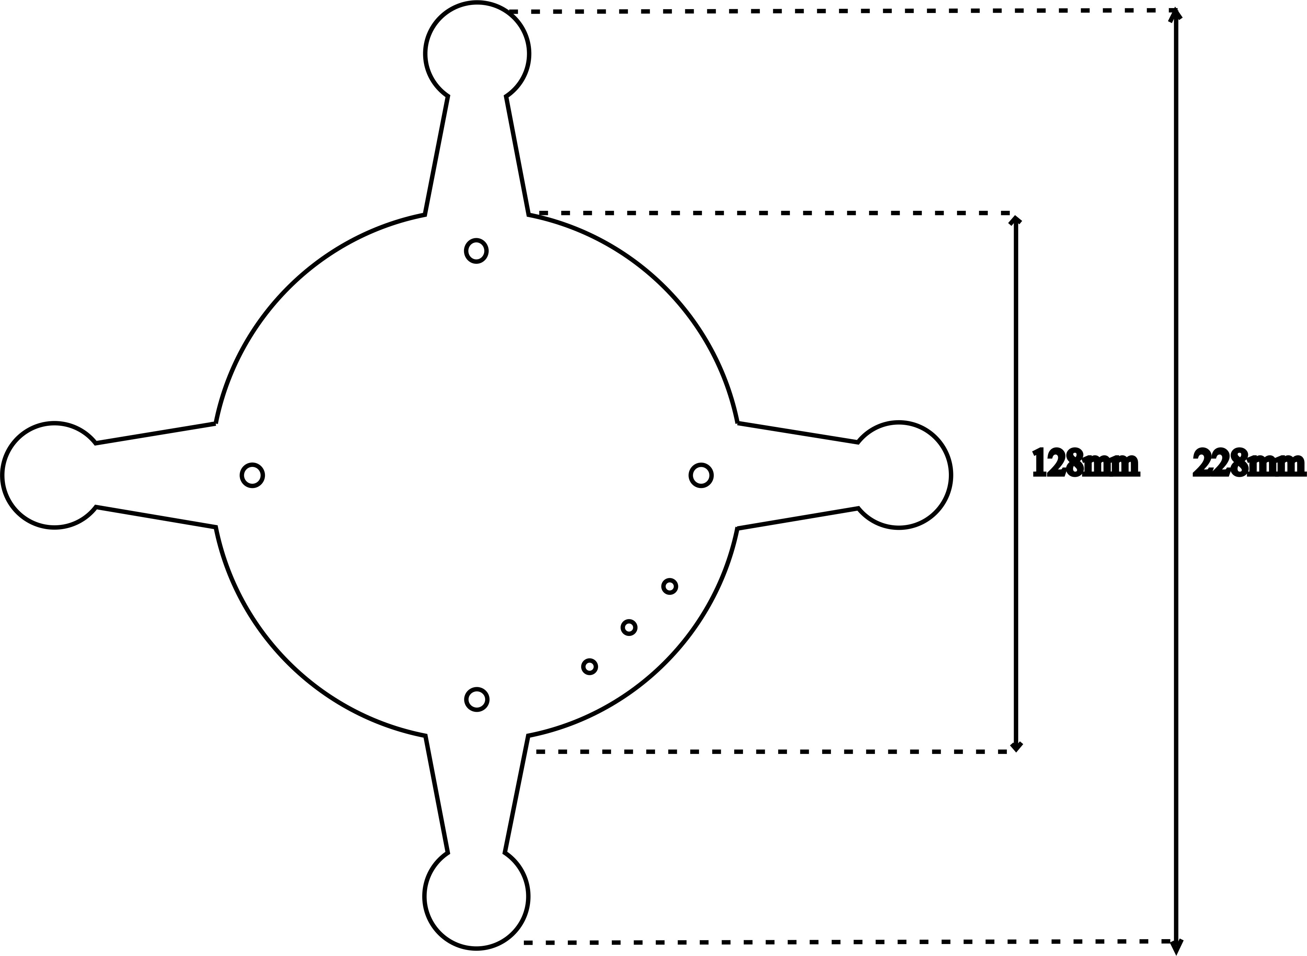
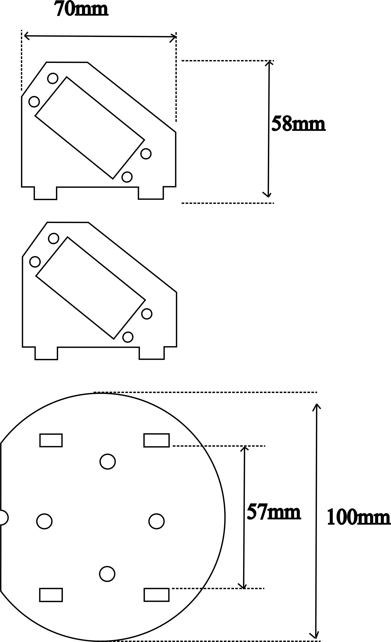
(a)
(b)
Figure(a)Base Template of Robotic Arm
(b)Shoulder Template of Robotic Arm

Slide 56
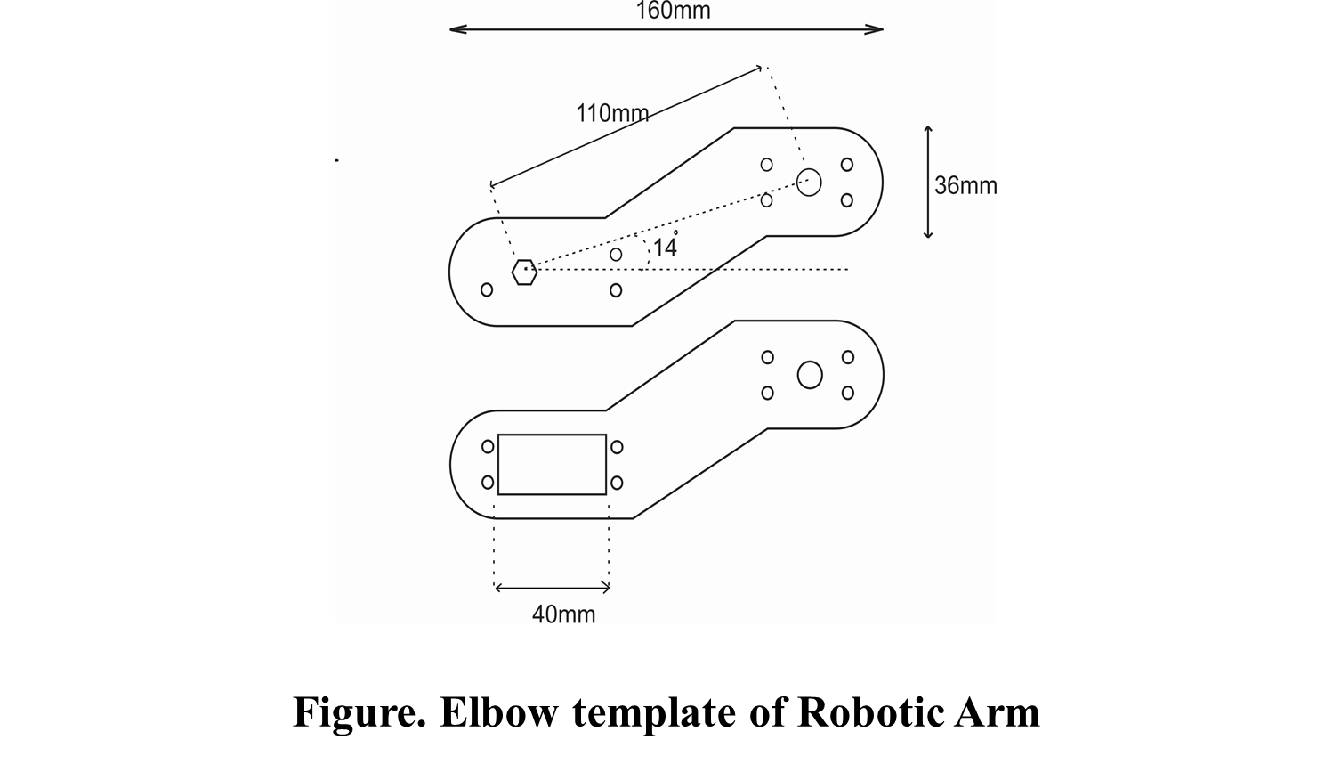
Figure. Elbow Template of Robotic Arm

Slide 57
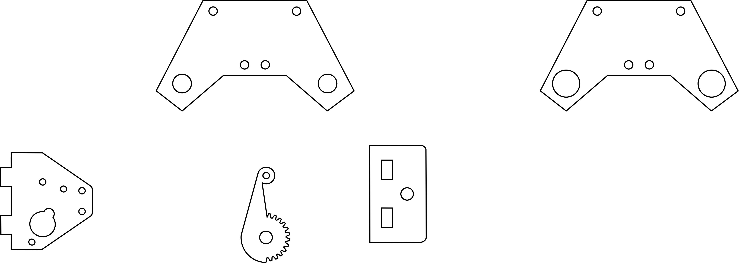
7mm
53mm
9mm
13mm
(a)
(b)
Figure. Gripper Pitch Templates of Robotic Arm
(a)For Servo Shaft (b)For Small Ball Bearing

Slide 58
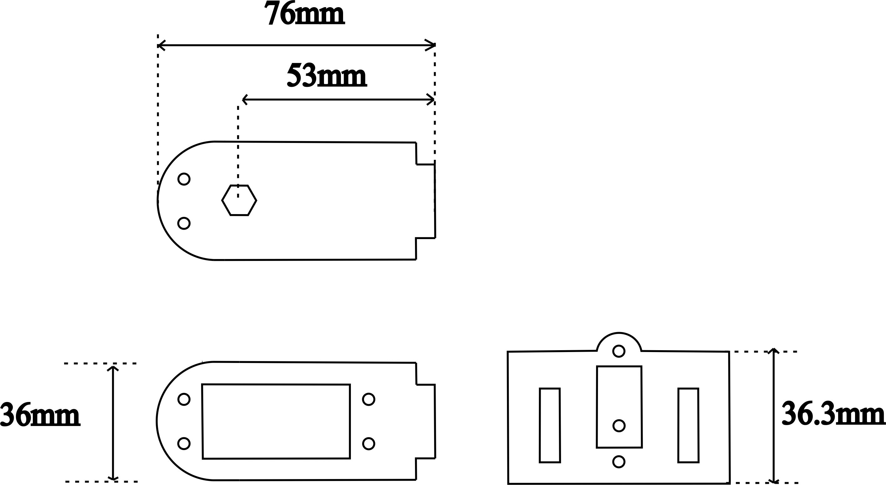
Figure. Gripper Spin Template of Robotic Arm

Slide 59
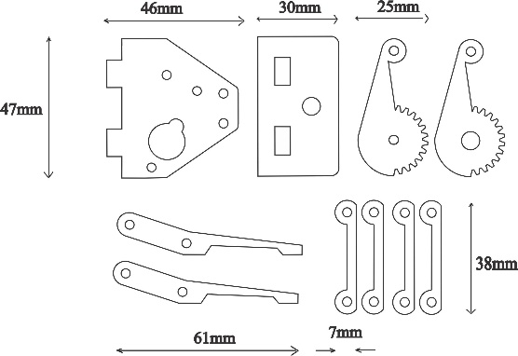
Figure. Gripper Template of Robotic Arm

Slide 60
Kinematic
Forward Kinematic
Inverse Kinematic
Analytic Method
Cosine Law

Slide 61
Forward Kinematic
The method for determining the orientation and position of the end-effector
The method for determining given the joint angle and link length

Slide 62
Inverse Kinematic
To solve the given problem
To know the joint angle required

Slide 63
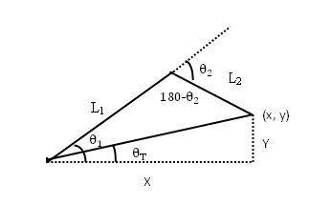
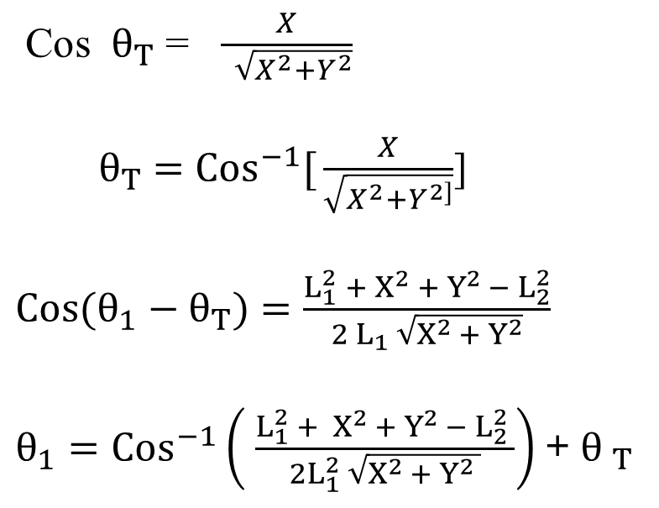
Analytic Method
Cos $θ_{T}$ = $\frac{X}{ \sqrt{X^{2}+Y^{2}}}$
${ θ}_{T}$ $=$ ${Cos}^{−1}[{\frac{X}{\sqrt{X^{2}+Y^{2]}}}}$]
$\operatorname{Cos}{(θ_{1}}−θ_{T})$ $=$ $\frac{L_{1}^{2}{ + X}^{2} +{ Y}^{2 }− L_{2}^{2}}{2 L_{1} \sqrt{X^{2 }+ Y^{2}}}$
$θ_{1}={Cos}^{−1}\left( \frac{L_{1}^{2} {+ X}^{2 }+ Y^{2 }− L_{2}^{2} }{2L_{1}^{2} \sqrt{X^{2 }+{ Y}^{2} }}\right)$+${ θ }_{T}$
Figure. Analytic Method for Solving the Inverse Kinematic

Slide 64
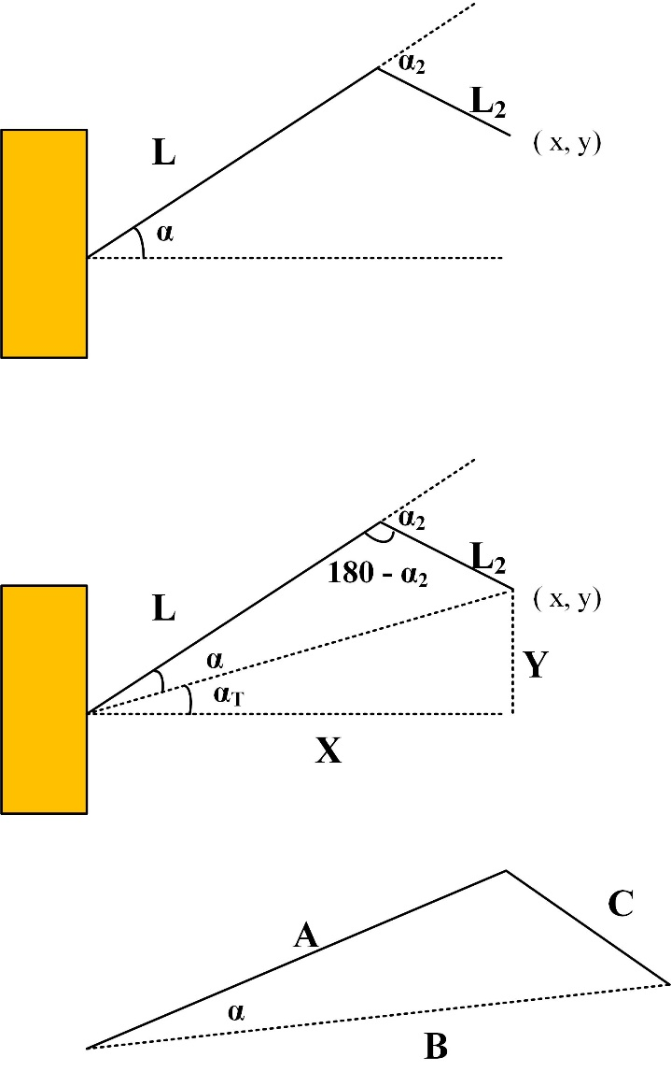
Cosine Law
Cos $α=\frac{A^{2}+B^{2}−C^{2}}{2AB}$ (Cosine Law.)
Figure. Cosine Law

Slide 65


